Slide 1
EXPLORATORY ANALYSIS OF RAINFALL DATA IN INDIA FOR AGRICULTURE
IBM-Project-5771-1658814926
Team ID : PNT2002MID17010
Team Leader | Manikandan K
Team Member 1 | Mariyappan K
Team Member 2 | Meiyazhagan M
Team Member 2 | Jeevanandhan B

Slide 2
India is an agricultural country and secondary agro based market will be steady with a good monsoon. The economic growth of each year depends on the amount of duration of monsoon rain, bad monsoon can lead to destruction of some crops, which may result in scarcity of some agricultural products which in turn can cause food inflation, insecurity and public unrest. In our analysis we are trying to understand the behavior of rainfall in India over the years, by months and different

Slide 3
Describing the data:
Data-set is downloaded from “data.gov.in” website. It has data for 117 years (1901–2017) consisting of monthly and seasonal data for all 36 meteorological subdivisions of India. So in total we have 117*12*36 = 50,544 observations. Our data-set had 0.7% of missing values. For the subdivision Arunachal Pradesh we had missing values for the first 15 years i.e. 1901 to 1915, so for all subdivisions we have considered data from 1916 to 2017 when we are analyzing as whole India. For the rest of the missing values we have used sequential imputation technique.
Below table shows mean rainfall observed for each month over years. We can see that average rainfall is high in July and August followed by June and September.

Slide 4
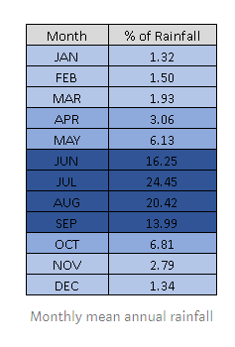

Slide 5
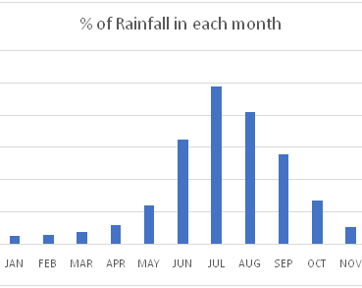
Annual rainfall by months: The below graph shows the percentage of rainfall each month receives when we consider India as a whole. The rainfall in the months of June, July, August and September together contribute to almost 80% of the annual rainfall.

Slide 6
Annual rainfall by subdivision:
The following is a heat map plotted based on sum of rainfall received by each subdivision for all these years. The subdivisions with large area represents high rainfall and with small boxes represent less rainfall. We can see that the subdivision located at Southwest and Northeast part of India have received more rainfall compared to central India.

Slide 7
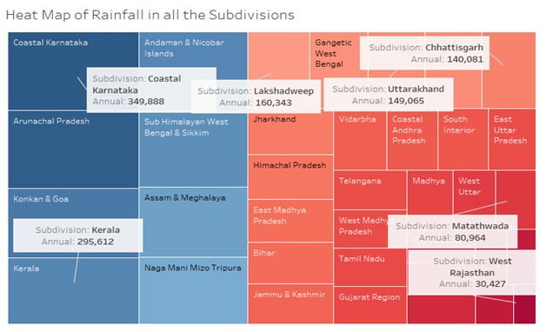

Slide 8
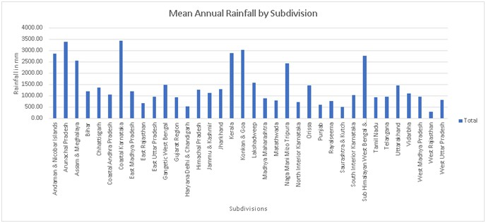

Slide 9
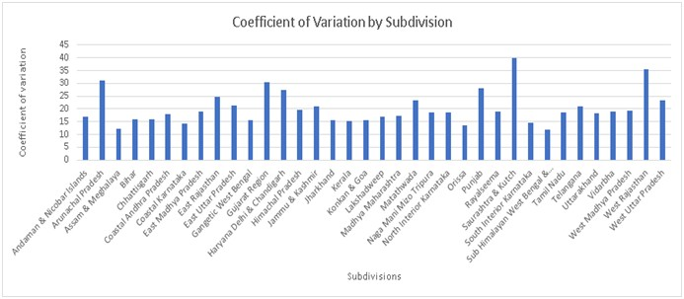

Slide 10
Understanding the Monsoon in India:
We will now move to a more interesting part of the analysis.
We will see what exactly is monsoon, different types of monsoon winds in India, which subdivisions of India receives rainfall from which monsoon winds and why only particular subdivisions receive highest rainfall during this monsoon season.
Before addressing these questions, we will see the basic concept of how rainfall actually occurs. So basically, during the summers, the Indian subcontinent heats up more as compared to the Indian ocean as the sun is directly over the landmass. This creates a low pressure over the Indian subcontinent and a relatively low pressure over the Indian ocean. And as we know, the wind flows from high pressure area to the low pressure are in order to fill the void that was created thanks to the pressure system. So when the wind starts flowing from high pressure area to low pressure are i.e. from sea to land, it picks up the moisture from the sea and while entering the indian subcontinent it comes in contact with the high terrains and hence precipitation occurs.
Now that we have understood how rainfall occurs we will now see what exactly is monsoon? Monsoon is traditionally defined as a seasonal reversal of wind accompanied by corresponding changes in precipitation.
As seen in the image below, India receives rainfall fromSouthwest Monsoon winds (Summer Monsoon or Advancing Monsoon) and Northeast Monsoon winds (Winter Monsoon or Retreating Monsoon)
The Southwest Monsoon usually starts in the first week of June and ends by first week of September and monsoon usually starts retreating from the Indian Subcontinent by the start of September and leaves the subcontinent completely by the end of November. And as we have seen in the previous graphs that Southwest monsoon provides almost 80% of the rainfall in India.

Slide 11
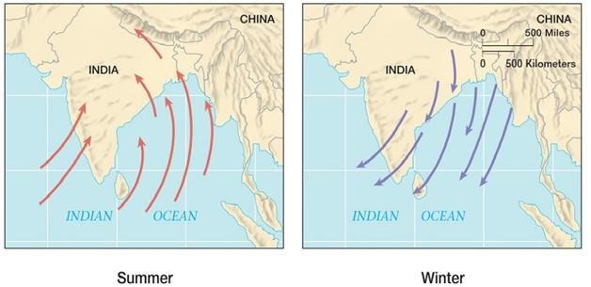

Slide 12
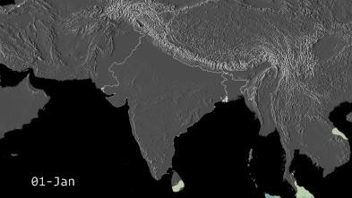
The following figure shows the cycle of monsoon in India over a year

Slide 13
Now, due to the presence of high rising Western Ghats which runs along the South West coast of India in the states of Kerala, Karnataka, Goa and Maharashtra, they block the Arabian Sea branch of southwest monsoon and hence these regions receive very high rainfall during monsoon season. This is shown in the graph below. (For all the graphs we have considered the last 3 decades i.e. last 30 years data (1987–2017))

Slide 14
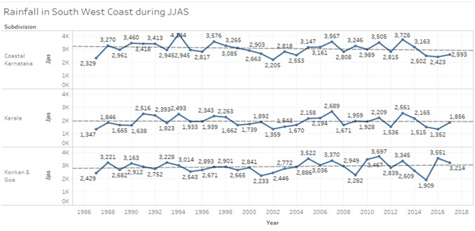

Slide 15
The Bay of Bengal branch of the Southwest Monsoon provides rainfall to the eastern and north eastern regions of India. Due to the presence of the eastern ghats along Orissa and West Bengal, these regions receive high rainfall in the East and when this branch reaches the north eatsern part of India
i.e. Sikkim, Arunachal Pradesh, Assam & Meghalaya, due to the presence of Khasi hills and other hilly areas, these subdivisions receive very high rainfall. Cherrapunji in Meghalaya is titled as one of the
wettest places on earth.

Slide 16
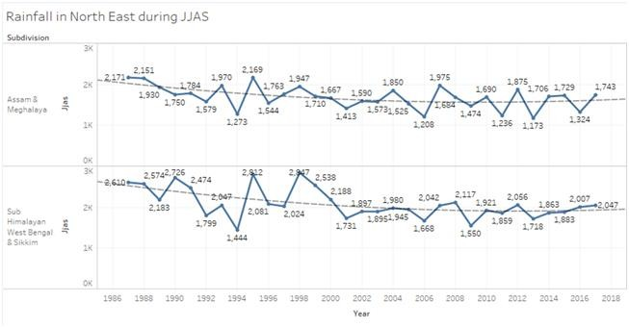
The average annual rainfall in these regions is shown in the graphs below.

Slide 17
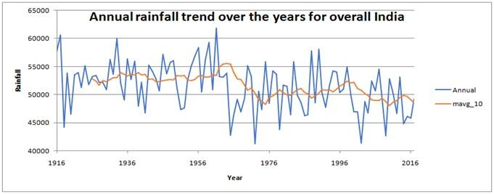
Annual Rainfall trend over the years for whole India
10 years moving average was plotted, we can see that there is a decreasing trend in rainfall in the recent years.

Slide 18
Rainfall Data Analysis for Subdivision TamilNadu
To do rainfall data analysis of Tamil Nadu subdivision, we have considered the data from year 1901 to 2017. First we will see the distribution of rainfall over months and we can see in below figure that rainfall is more in October and November compared to other months as Tamilnadu receives rain during retreating monsoon season because of Northeast trade winds.
The climate of Tamil Nadu is tropical in nature with less variation in temperature in summer and winter. This is because of its geographical location.

Slide 19
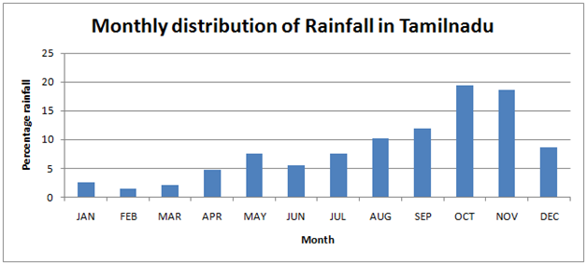

Slide 20
The below graph shows rainfall in Tamil Nadu in months October and November here we can see that most of the years when there is very low rainfall in October there is very high rainfall in November and vice versa. Tamil Nadu also rainfalls from tropical cyclones emerging in the neighborhood of Andaman islands during the retreat monsoon.
In 2015 there were south Indian floods, the flooding in Chennai was described as the worst in a century. In winters of 2017 the worst drought in a century happened in southern India.

Slide 21
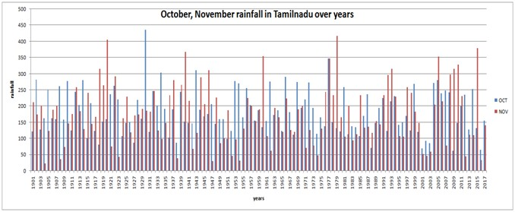

Slide 22
import numpy as np # linear algebra
import pandas as pd # data processing, CSV file I/O (e.g. pd.read_csv)
import matplotlib. Pyp lot as plt
import seaborn as sns
import random
# Input data files are available in the "../input/" directory.
# For example, running this (by clicking run or pressing Shift+Enter) will list all files under the input directory
import os
for dirname, _, filenames in os. walk('/kaggle/input'):
for filename in filenames:
print(os .path. join(dirname, filename))
In [7]:
data = pd. read csv('/content/rainfall_India_2017
(1).csv').rename(columns=str. lower)
data. head(3)
Out[7]:

Slide 23
 | subdivision | Year | jan | feb | mar | apr | may | jun | july | aug | sep | oct | nov | dec | annual
0 | Andaman Nicobar Islands | 1901 | 49.2 | 87.1 | 29.2 | 2.3 | 528.8 | 517.5 | 365.1 | 481.1 | 332.6 | 388.5 | 558.2 | 33.6 | 3373.2
1 | Andaman Nicobar Islands | 1902 | 0.0 | 159.8 | 12.2 | 0.0 | 446.1 | 537.1 | 228.9 | 753.7 | 666.2 | 197.2 | 359.0 | 160.5 | 3520.7
2 | Andaman Nicobar Islands | 1903 | 12.7 | 144.0 | 0.0 | 1.0 | 235.1 | 479.9 | 728.4 | 326.7 | 339.0 | 181.2 | 284.4 | 225.0 | 2957.4

Slide 24
data.info()
RangeIndex: 4188 entries, 0 to 4187
Data |  | columns (total 15 columns):
# |  | Column Non-Null Count |  |  | Dtype
0 |  | subdivision | 4188 | non-null |  | object
1 |  | year | 4188 | non-null |  | int64
2 |  | jan | 4184 | non-null |  | float64
3 |  | feb | 4185 | non-null |  | float64
4 |  | mar | 4182 | non-null |  | float64
5 |  | apr | 4184 | non-null |  | float64
6 |  | may | 4185 | non-null |  | float64
7 |  | jun | 4183 | non-null |  | float64
8 |  | jul | 4181 | non-null |  | float64
9 |  | aug | 4184 | non-null |  | float64
10 |  | sep | 4182 | non-null |  | float64
11 |  | oct | 4181 | non-null |  | float64
12 |  | nov | 4177 | non-null |  | float64
13 |  | dec | 4178 | non-null |  | float64
14 |  | annual | 4162 | non-null |  | float64
dtypes: float64(13), int64(1), object(1) memory usage: 490.9+ KB

Slide 25
print('Dataset comprises of {} observations
and {}
characteristics'.format(data.shape[0],data.
shape[1]))
print('\nUnique Values: ',data.nunique())
print('\nMissing Values:
',data.isna().sum())
Dataset comprises of 4188 observations and
15 characteristics
Unique | Values: | subdivision
year |  | 117
jan |  | 808
feb |  | 902
mar |  | 989
apr |  | 1247
may |  | 1751
jun |  | 2754
jul |  | 3093
aug |  | 2950
sep |  | 2664
oct |  | 1958
nov |  | 1245
dec |  | 810
annual |  | 3770
dtype: | int64
36

Slide 26
Missing | Values: | subdivision | 0
year |  | 0
jan |  | 4
feb |  | 3
mar |  | 6
apr |  | 4
may |  | 3
jun |  | 5
jul |  | 7
aug |  | 4
sep |  | 6
oct |  | 7
nov |  | 11
dec |  | 10
annual |  | 26
dtype: | int64

Slide 27
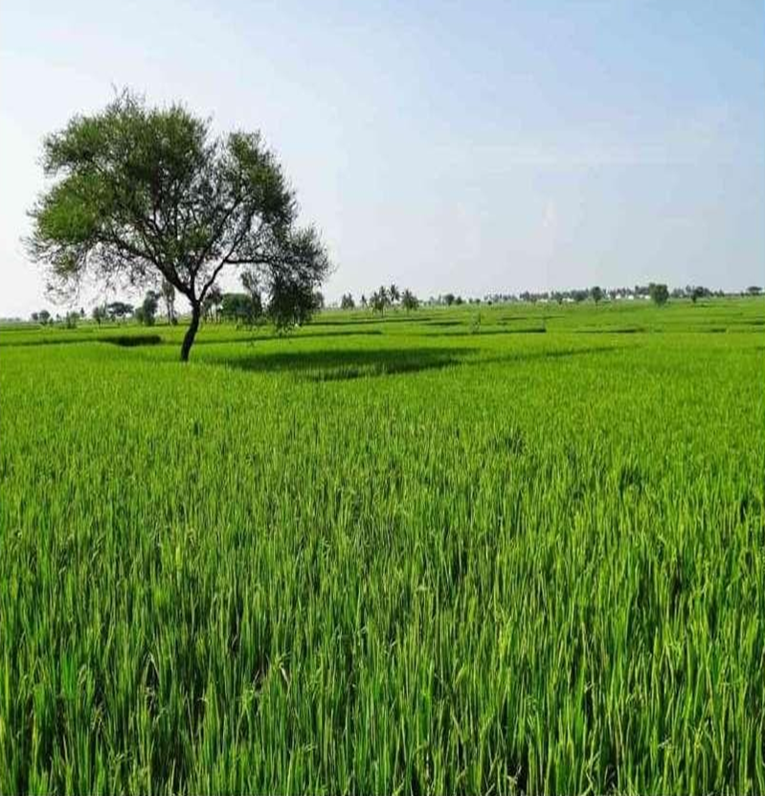

Slide 28
THANK YOU

